Slide 1
Icici Bank Web Page
by: Yogesh Sapkal

Slide 2
Introduction
The Industrial Credit and Investment Corporation of India Limited(ICICI) is indias largest private sector bank by market capitalisation and secound largest overall in terms of assets.
Vision to be the leading provider of financial services in India and a major global bank.
Maintain a healthy financial profile and diversify our earnings across buisnesses.
Maintain high standerds of governance and ethics.

Slide 3
Software Requirement
Frontend: Html, CSS, Java-Script, Ajax.
Backend: Java, Jsp, Servlet, JDBC.
Database: MySql(InnoDB).
Framework: Hibernate.

Slide 4
Hibernate Framework
Hibernate is a java framework that simplifies the development of java application to interact with the database. It is an open source, lightweight, ORM(Object Relational Mapping) tool.
Hibernate implements the specifications of JPA (Java Persistence API) for data persistence.

Slide 5
ORM tool
An ORM tool simplifies the data creation, data manipulation and data access.
It is a programming technique that maps the object to the data stored in the database.
The ORM tool internally uses the JDBC API to interact with the database.

Slide 6
Advantages of Hibernate
Open Source and Lightweight.
Fast performance.
  It is fast because cache is internally used in hibernate.
  There are two types of cache first level cache and second level cache.First level cache is enabled by default.
Database Independent Query
  HQL(Hibernate Query Language) is the object oriented version of SQL.It generates the database independent queries.
Automatic table Creation
  Hibernate provides the facility to create the tables of the database automatically.

Slide 7
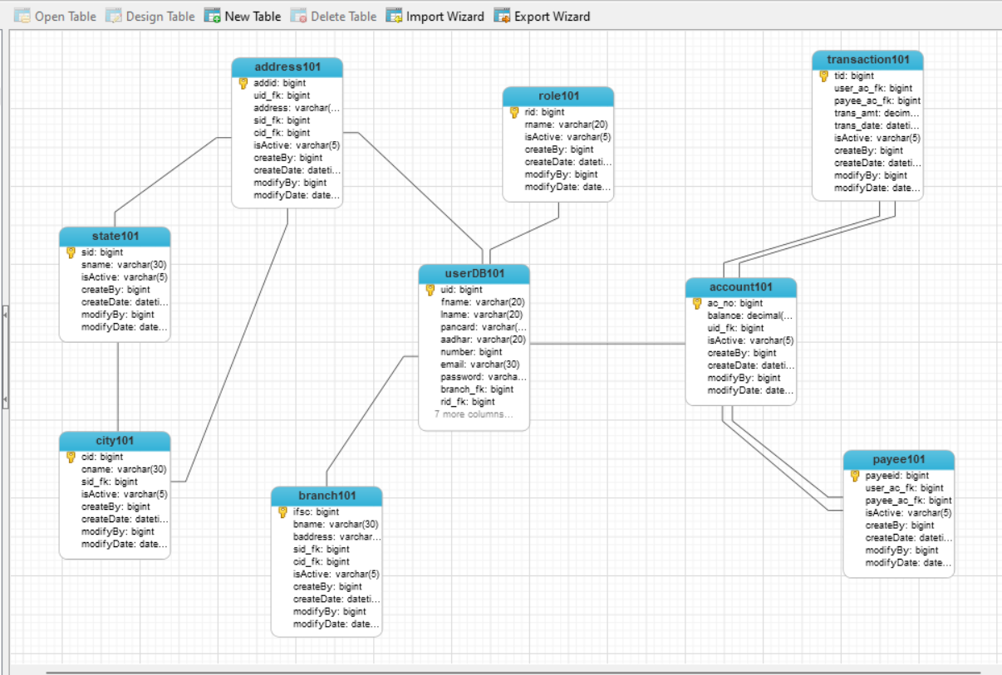
ER Diagram

Slide 8
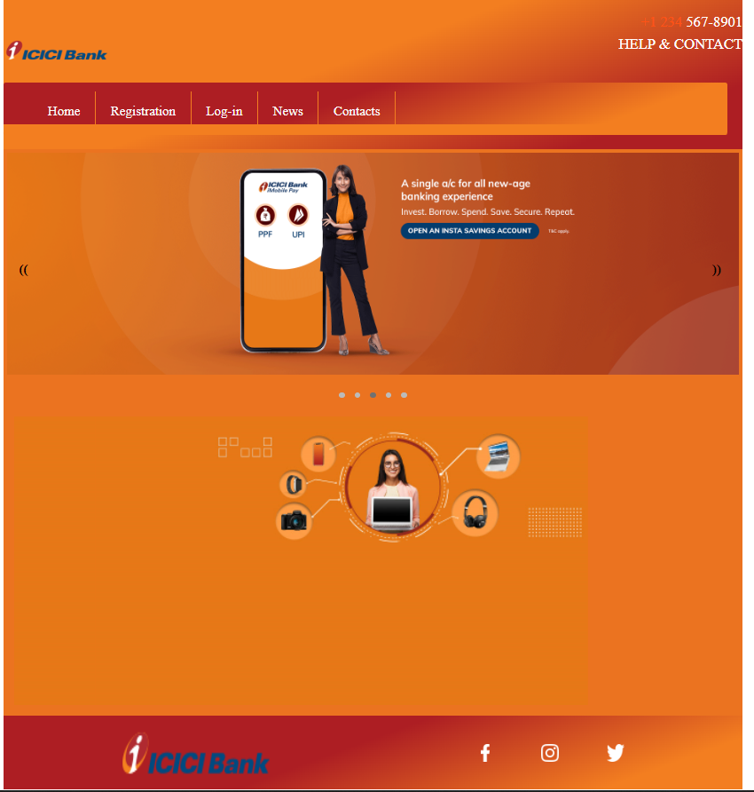
UI Diagram and Flow of Website
1. Home Page

Slide 9
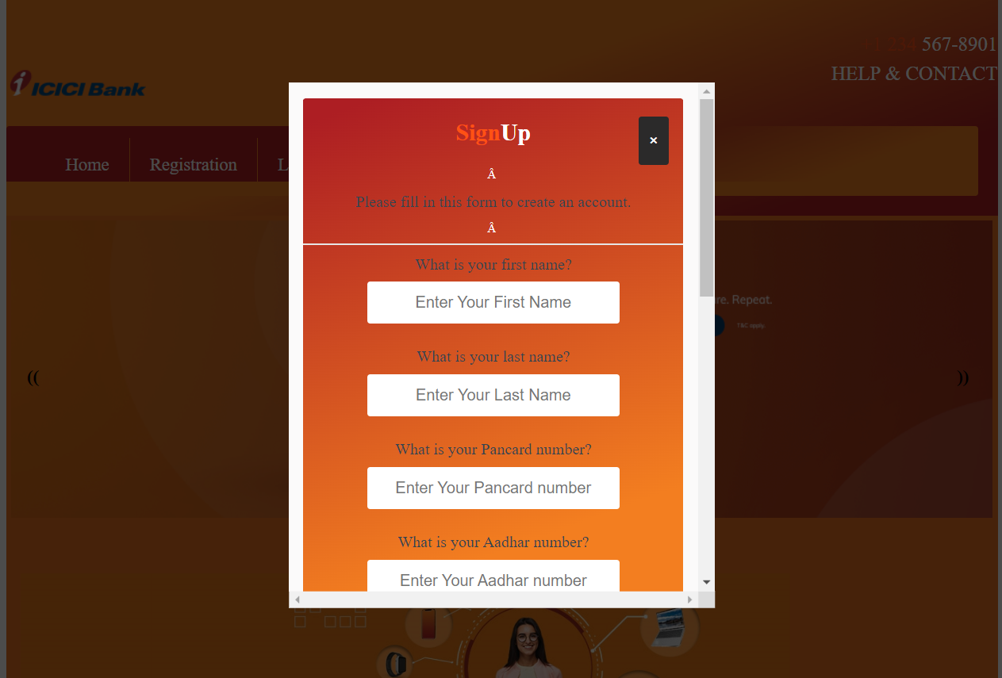
UI Diagram and Flow of Website
2. New user needs to sign up

Slide 10
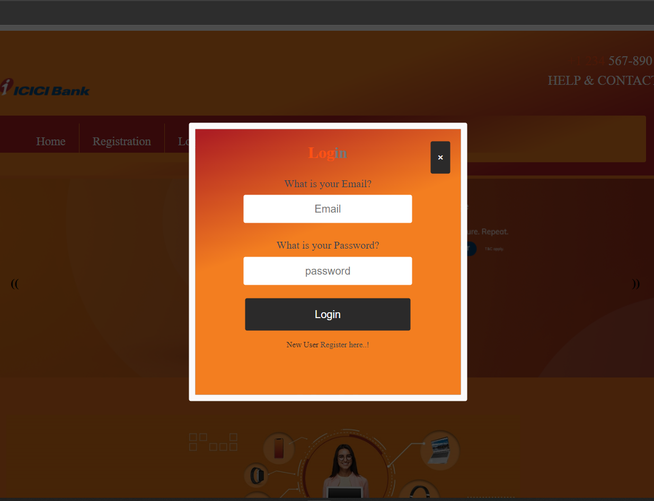
UI Diagram and Flow of Website
3. After sign up user will login

Slide 11
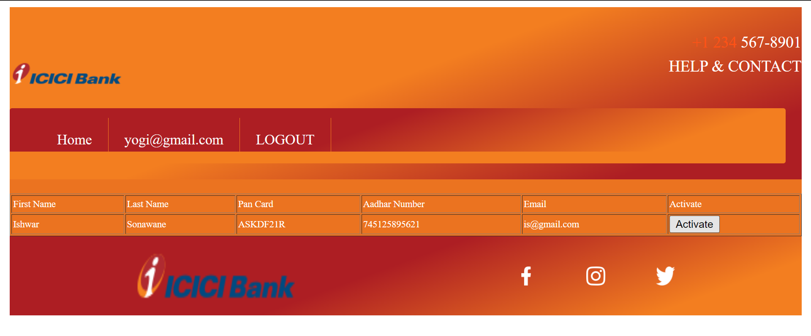
UI Diagram and Flow of Website
4. (Admin Page)After successful login User will not be able to login because after admin will activate that user and their account will be credited

Slide 12
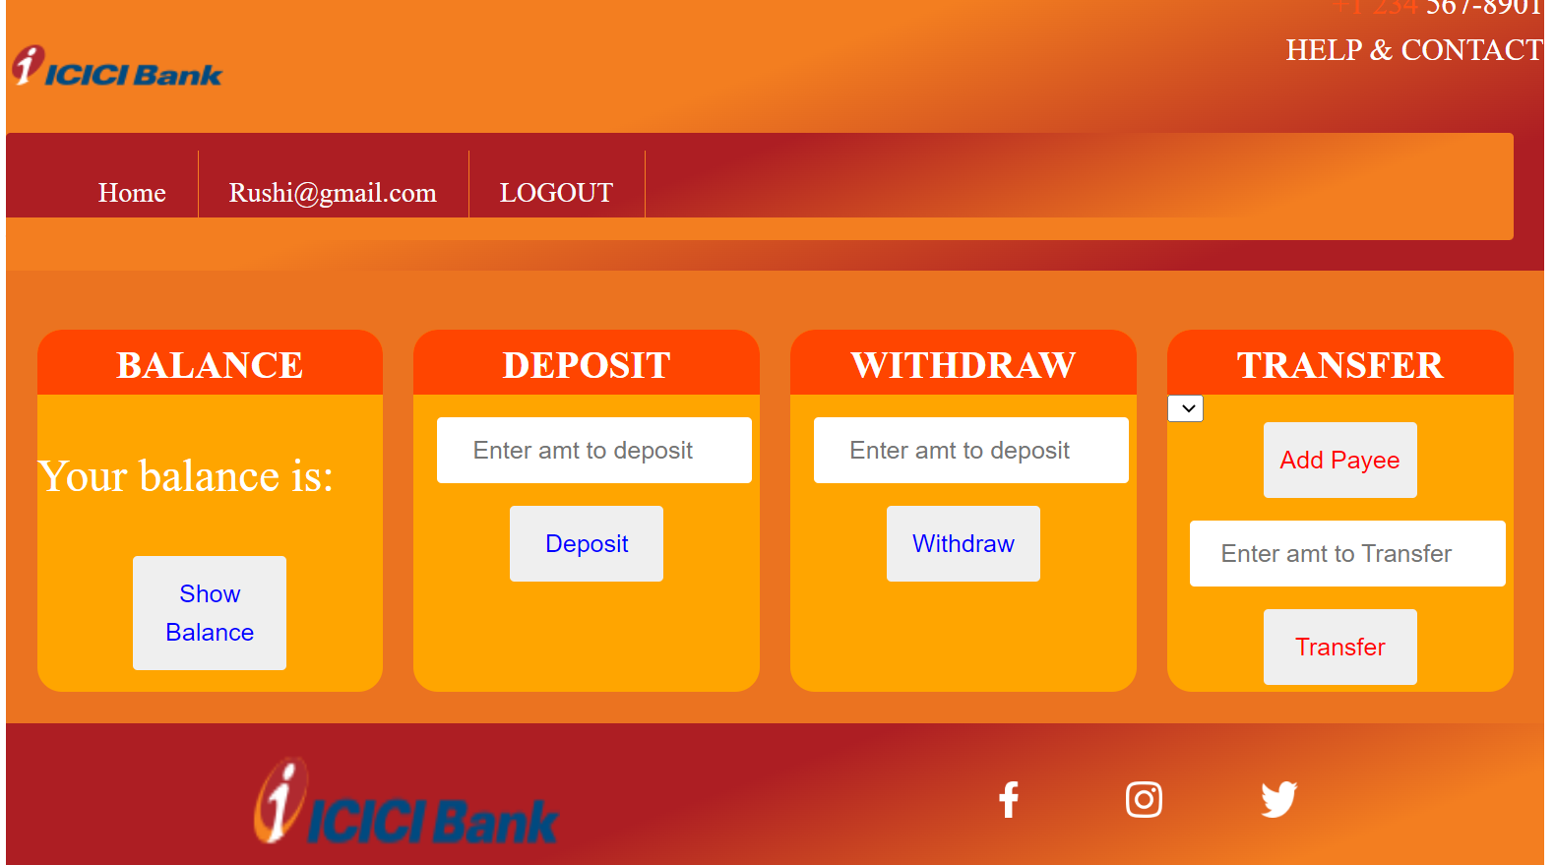
UI Diagram and Flow of Website
5. After activation user can login and goes to the service page.

Slide 13
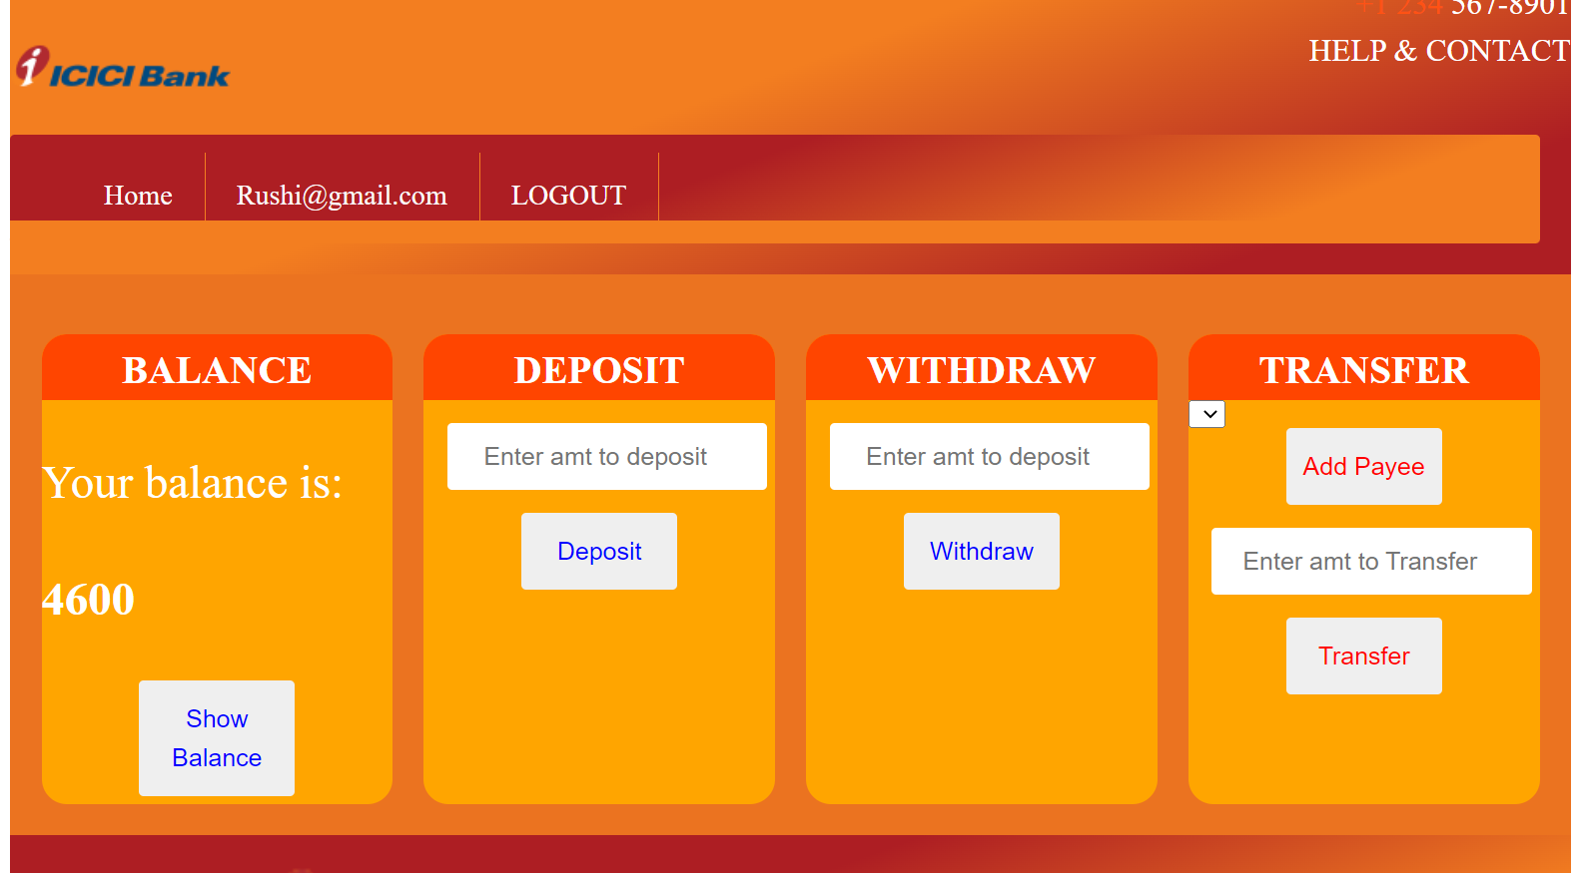
UI Diagram and Flow of Website
6. by clicking show balance user can see his balance.

Slide 14
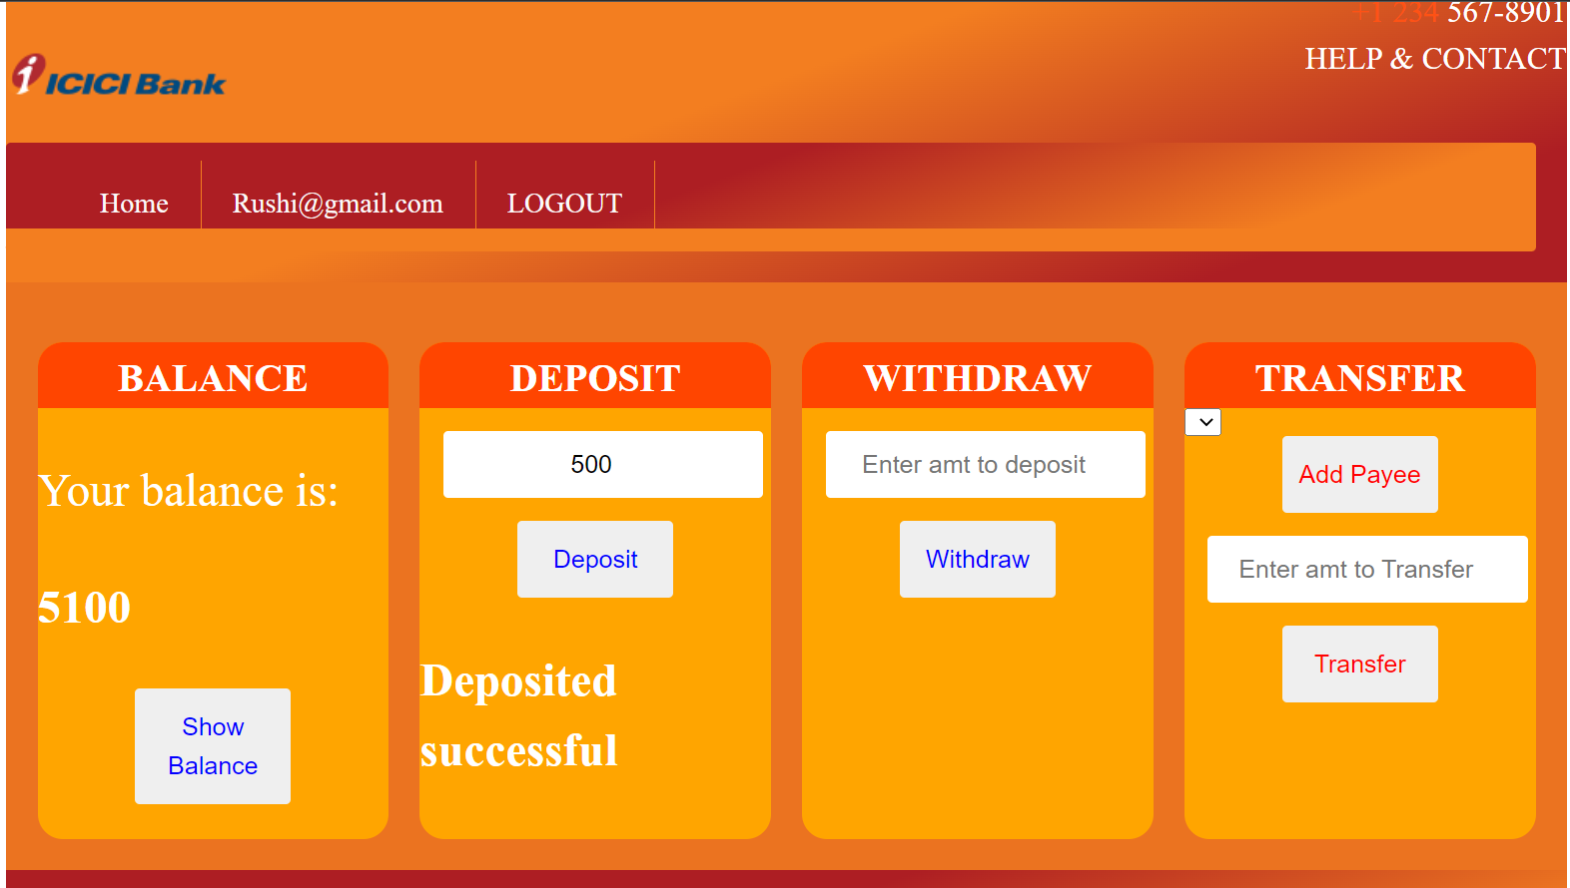
UI Diagram and Flow of Website
7. by clicking Deposite user can add amount in his account..

Slide 15
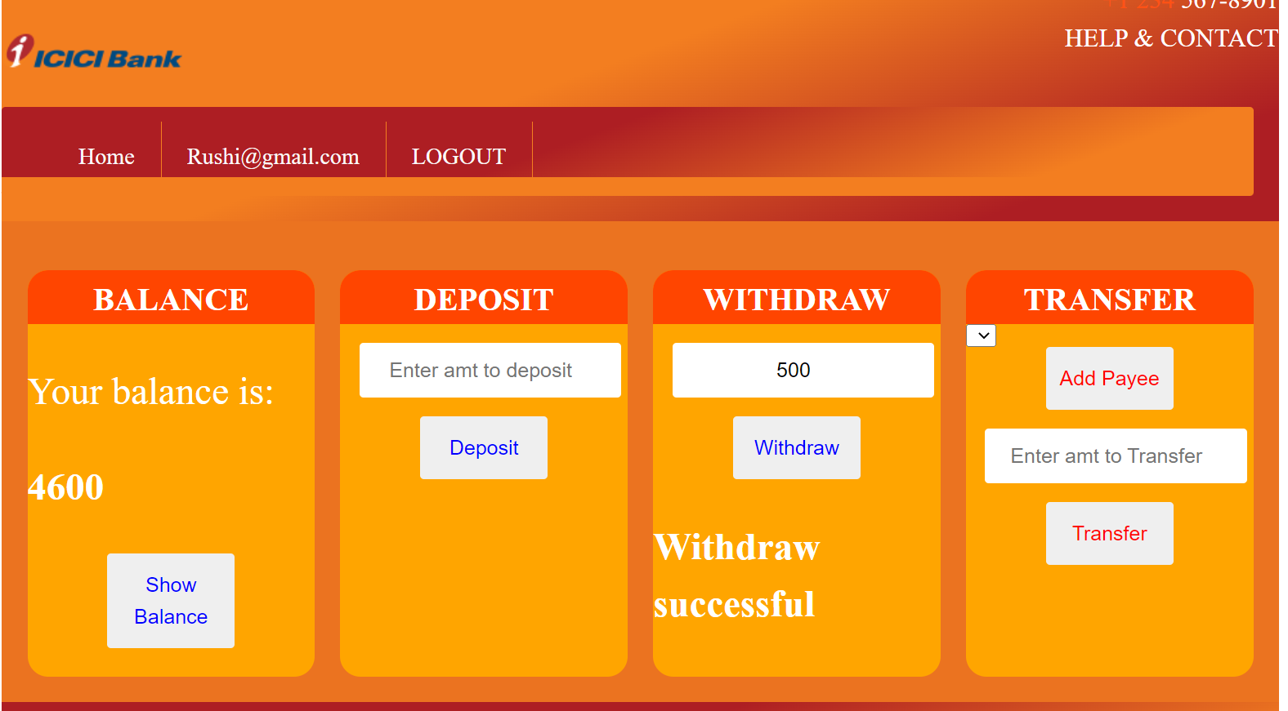
UI Diagram and Flow of Website
8. by clicking withdraw user can withdraw any amount which is in his account.

Slide 16
THANK YOU

